Slide 1



SAP HANA 平台介绍
Notes:
At FKOMs we will announce SAP Business Suite 4 SAP HANA (short SAP S4HANA), a new product and the next generation of the Business Suite. S4HANA runs on HANA (only) and includes ALL simplifications (sFIN, sLOG, s…).
S-innovations will only be used as internal name of the program that is developing all the Simplifications.

Slide 2


什么是SAP HANA平台?

Slide 3





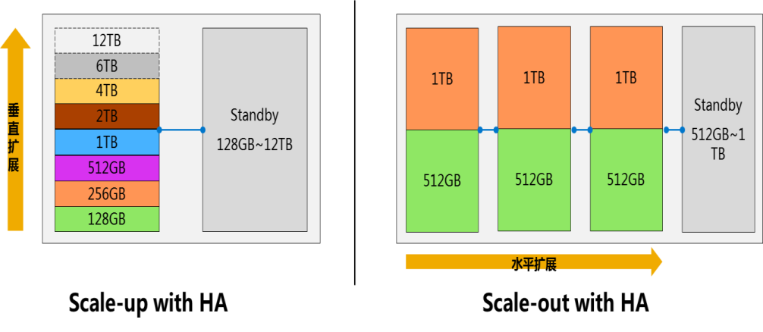






通用标准的硬件，支持灵活的扩展性 通过设备一体机的方式交付给客户
SAP HANA运行于标准的x86硬件和Power Linux之上，目前有10家供应商可提供HANA一体机
SAP HANA运行在标准的硬件模块上，硬件合作伙伴仅做少量的更改
SAP联合主流的硬件厂商提供HANA系统
最大支持24TB设备
最大支持56节点/2TB每节点
SAP HANA硬件的关键组件：
基于Intel Ivybridge E7 v2处理器，单台系统上可以配置2、4、或8颗CPU（即30、60、120核）
内存大小通常等于 128GB * CPU个数。在中等配置的设备上配置了4颗CPU以及1024GB内存
日志存储 - 通常用Fusion-IO ioDrive，容量和内存大小保持一致
磁盘存储 - 各厂家不尽相同，可以是本地SAS机械磁盘、或者网络存储

Slide 4


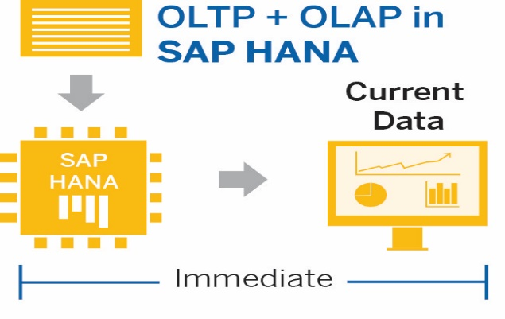

数据完全的内存处理
现代化的计算架构瓶颈已经从磁盘到内存的限制转变到内存到CPU缓存的限制
Disk to Memory
CPU
Memory
不需要数据库调优
不需要索引
不需要缓存
不需要物化视图
Bottleneck
Hard Disk: 10,000,000ns* / SSD: 200,000ns*
Disk Storage
Log
Memory to CPU Cache
Core 1
Core N
CPU
1.5ns*
L1 Cache
4ns*
L2 Cache
数据扫描
32
亿
秒
数据聚合
12.5
百万
核/秒
数据合成
1.5
百万
核/秒
15ns*
L3 Cache
60ns*
Memory
Storage
Log

Slide 5

SAP HANA一些技术特征
+
T
+
+
+
+
行列混合存储
仅插入的变更
最小的命中范围
文本搜索
不需要聚合
A
P
t
历史数据分析
多核并行计算
多线程多节点计算
内存压缩
主动/被动的数据分层
SQL
+
+
+
x
分区
行列数据统一SQL查询
单租户/多租户
动态扩展
减少数据层次
分布式计算
Map-reduce
关键字组合
内存应用
批量加载

Slide 6

内存计算架构
任何应用
任何应用服务器
SAP 商务套件
SAP数据仓库/分析套件
支持多种设备形式
SQL
MDX
R
JSON
Open Connectivity
SAP HANA平台
SQL, SQLScript, JavaScript
空间
搜索
文本挖掘
存储过程和数据模型
应用和UI服务
业务功能库(BFL)
预测分析库(AFL)
数据库服务
计划引擎
规则引擎
复制、流处理和ETL集成服务
事物
非结构化
机器
HADOOP
实时
位置
其它应用
Notes:
在HANA上可以做哪些事情？谁最早采用该技术，他们获得了哪些收益？

Slide 7





SAP HANA 创新平台集成架构
UI
Connectivity
SAP NetWeaver Portal
SAP Fiori SAP UI5 / HTML 5
Native Mobile Apps
Application
S/4HANA
SCM
Non-SAP
BW
Gateway
SAP HANA Cloud Integration
Parallel Processing Engines
HANA Live
HANA native
Cloud Connector
SQL
OLAP
Predictive
Text
Spatial
Rules
Graph
SAP Process Integration/ Orchestration (PI/PO)
Data Stores
Event Streaming
SAP HANA In-Memory
HANA Extended Storage
Column Store
Row Store
Orchestration
Certified Hardware
SAP Solution Manager
Scale-Up
Scale Out - Cluster
Internet of Things
Structured & transactional data
Un-structured data
Hadoop

Slide 8




SAP HANA 的极致应用 技术创新使业务创新成为可能
旧有限制的关键，在于缺乏高效强大的数据平台；新的期待，也离不开创新性的平台支持
简化的架构设计与创新的内存计算技术， 解决过去企业内部认为难以解决的瓶颈问题
内嵌的建模、预测、分析、报表、函数库等工具的快速开发支持，使得IT系统能够适应业务的快速发展与变化
客户端
Crystal Report Pervasive Analysis Interactive Analysis BOBJ Extreme Apps …
个人客户端
HTTP(S) / ODATA, XMLA SQL, MDX
XS Engine
Control flow (JavaScript)
DI Server+ / Service
流程控制 (JavaScript)
Control flow (JavaScript)
商业物件BO
语意层 Semantic Layer
查询视图 - Query View
重用视图 - Reuse View
SQLScript
物理表 - Physical Table
HANA SERVER
Notes:
首先需要说明，旧有应用的不成功，主要是因为缺乏一个好的平台，而新的应用想成功，也需要一个新的平台的支持。
renovation/innovation via new HANA technology
接着说明HANA的各种创新点（内存计算、简化架构、内嵌各种开发工具模型，快速开发、快速部署等等）
只有有了如此强大的应用，才能使业务创新成为可能，否则业务创新只是空中楼阁，缺乏支撑。

Slide 9
应用开发平台的选择……
传统方式
延时-冗余-复杂
内存计算平台方式
快速 – 简单 – 创新
Planning & Optimization Application
Ad-hoc Reporting Application
Hybrid Data Analytic Application
Internet of Things (IoT) Applications
Predictive Application
Planning & Optimization Application
Ad-hoc Reporting Application
Hybrid Data Analytic Application
Internet of Things (IoT) Applications
Predictive Application
App
Server
App
Server
App
Server
App
Server
App
Server
One In-memory Platform
DB Server
DB Server
DB Server
All data, One Copy, Real-time Processing
Geospatial
Data
HR Data
Copy
CRM
Data Copy
Web Data
Streaming Data
SCM
Data Copy
Financial Data Copy
Batch Data Movements
Data Staging

Slide 10

SAP HANA平台: 内存计算平台适用于所有类型的应用
客户导向的使用体验
SAP Fiori, SAP Lumira, SAP Business Objects
开放的接口
SQL
MDX
R
JSON
Open Connectivity
SAP HANA Platform
内存计算
嵌入式的计算库
OLTP & OLAP
简化开发架构
所有数据一份副本
Application Services
Database Services
Integration Services
Structured
Data
Geospatial Data
Machine Data
Social Network Data
Text Data
For Cloud and On-premises
Notes:
To build applications, you need a good application development platform. SAP HANA Platform is the in-memory application development platform for all your application.
With SAP HANA as the common platform, we help our customers dramatically accelerate the speed of their business while radically simplifying their IT stack by collapsing complex IT layers reducing hardware costs.
In addition, the SAP HANA platform brings the seamless integration across our core applications and analytics solutions, offering a truly integrated closed-loop experience from insight to action
SAP HANA platform allows you to build transaction applications and analytic applications on the same platform, which means you can run analytic on top of transactional data directly. It help you to generate the real-time analysis on the fresh data and provide the single version of truth for your analysis.
And, now, SAP, partners, ISVs, startups, and also some customers are building new applications on top of SAP HANA platform.
SAP HANA can help you to:
1. accelerate your application performance: SAP HANA uses advanced in-memory computing that removes the bottle neck of disk IO with less data movement
2. simplify your application development: No need to have additional data copies. All applications can run on top of the same platform and a single data copy
3. Innovate in your application intelligence with real-time insights: SAP HANA seamlessly integrates engines to process different data to help finding deeper insights.
With real-time deep insights and simplified development, you can do continuous innovation and build more new applications that dedicates to your own business to help run better.
Innovate to compete

Slide 11
SAP HANA平台包含哪些特性?

Slide 12







一个平台中提供所有集成服务
SAP Applications
Custom Applications
Third-Party
Applications
SAP HANA Platform
Application Services
Web Server | JavaScript | Fiori UX | Source Code Management
Database Services
OLTP + OLAP | Data Modeling | Stored Procedures | Rules | Libraries | Search
Text Analytics
|
Graph
|
Planning
|
Spatial
|
Predictive
|
Streaming
Integration Services
Smart Data Access | Smart Data Integration | R-Integration
应用服务，数据库服务，集成服务 全部都集成在同一个内存计算平台中
大量的数据在内存中运行复杂分析和交易
处理与统一/简化数据访问、 建模和管理异构数据
Notes:
Multiple engines in-memory on the same platform :
Provides powerful analytic service, such as search, text analytic, predictive analysis;
and built-in web server to access static content stored in SAP HANA repository
Optimize database connector to access in-memory data faster
Support attractive and dynamic HTML5 UI via OData services or by writing native application-specific code that runs in SAP HANA context

Slide 13




SAP HANA Platform – Integration Services 来自任何来源的完整视图的业务数据
SAP HANA Platform
Application Services
Database Services
Integration Services
Smart Data Access
Smart Data Integration
Hadoop Integration
R Integration
Federation
Loading
IBM DB2, Netezza, Oracle, MS SQL Server, Teradata, SAP HANA, SAP ASE, SAP IQ, HIVE
IBM DB2, Oracle, MS SQL Server, Twitter, OData, Custom Adapters
不同类型的数据同时存储在内存数据库
任何类型的数据可以在云存储和本地存储之间复制和移动
在HANA和Hadoop之间创建多个访问点

Slide 14
SAP HANA Platform – Database Services 创新的平台
SAP HANA Platform
Application Services
Database Services – Foundation and Processing Capabilities
In-Memory ACID Columnar
Multi-Core / Parallelization
Advanced Compression
Multitenant Database Containers
Dynamic Tiering
Integration Services
快速数据处理
实时数据聚合不需要额外的索引
交易数据和分析数据一个副本处理
云计算就绪
不限制于内存容量
Notes:
We can process data faster because, data is managed in memory (not bound by the disk), process data in parallel leveraging multi-core, process compressed data.
We can aggregate data on-the-fly in memory without indexes because, with columnar store every column is an index by default.
We can process OLTP + OLAP on single copy of data in the same system because, data is in memory and SAP HANA’s columnar store uses temporary delta storage for processing high speed transactions.
We are cloud ready database because multiple tenant databases can run in one SAP HANA system/instance allowing to manage shared infrastructure securely and efficiently.
Strong separation of data, resources and users among tenant databases. Manage multiple databases as a unit. Flexibility to allocate memory and/or CPU per tenant database.
We can support petabyte scale deployment - not confined by the size of memory because warm data can be stored on disk in a columnar format and accessed transparently.

Slide 15
SAP HANA Platform – Database Services 综合先进的数据处理与分析
SAP HANA Platform
Application Services
Database Services – Foundation and Processing Capabilities
Spatial
Graph
Predictive
Search
Text Analytics
Streaming
Data Quality
Series Data
Function Libraries
Integration Services
特色明显不同的数据类型在同一系统中运行的应用程序
优化流、 图、 规划、 和规则上相同的数据的应用程序
使您的业务，通过内置的预测分析，业务功能和数据质量
Notes:
Location intelligence for business data
Capability to analyze sentiments and summarize, classify and investigate text content
Search across structured and unstructured data
Live data stream capture, analysis and routing to appropriate storage or dashboard
Persistence, manipulation and analysis of network relationships and graphs without data duplication
Prepackaged predictive algorithms that operate on current data
Interactive planning without moving data to application server
Data cleansing of locally generated and imported data without post processing
Built in rule engine and business functions to accelerate application development

Slide 16
SAP HANA Platform – Application Services Web 服务器和数据库在一个系统中减少数据移动
SQL
JSON
ADO.NET
J/ODBC
OData
HTML5
MDX
XML/A
SAP HANA Platform
Application Services
Web Server
SAP Fiori UX
Application Lifecycle Management
Database Services
Integration Services
自动提供的任何设备，消费级用户体验
对开放的开发标准 — — HTML5，JSON，Java 脚本的支持
内置的工具来开发，版本控制，捆绑、 运输及安装应用程序

Slide 17
通过方便的开发工具提高开发效率和开放接口
开放平台支持多种语言的标准的 ODBC/JDBC 和 OData/RESTFul 的 Web 服务调用
深入地结合 ABAP 编程环境
支持 Web IDE 允许使用瘦客户端编程
HANA Studio
Flexible and Complete
Fully support HANA features
ABAP Studio
Support ABAP Programing
NetWeaver
SAP Java development environment
Web IDE
Simplicity
Professional Developers
ABAP IDE
Simplicity
Professional Developers
Bring your Own Tool
Openness. Access SAP HANA through standard JDBC/ODBC or OData RESTFUL Web Services
Eclipse
Orion
REST / SQL Interface
SAP HANA Platform
Fiori Library
PAL/BFL
Lumira Library
SAP UI5

Slide 18
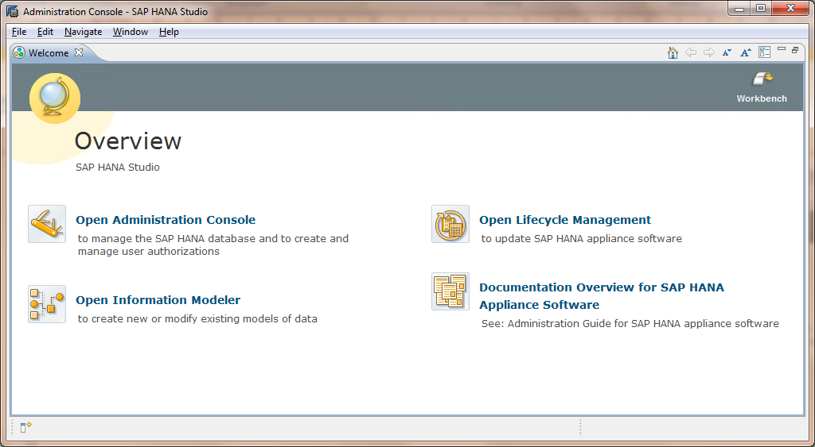
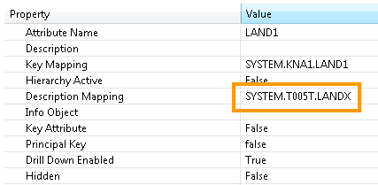
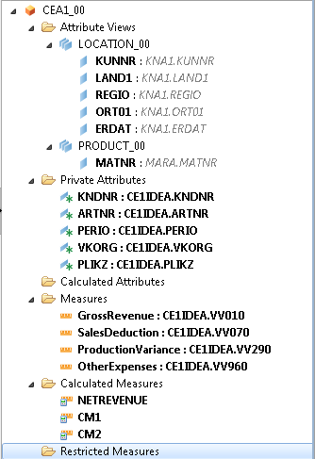
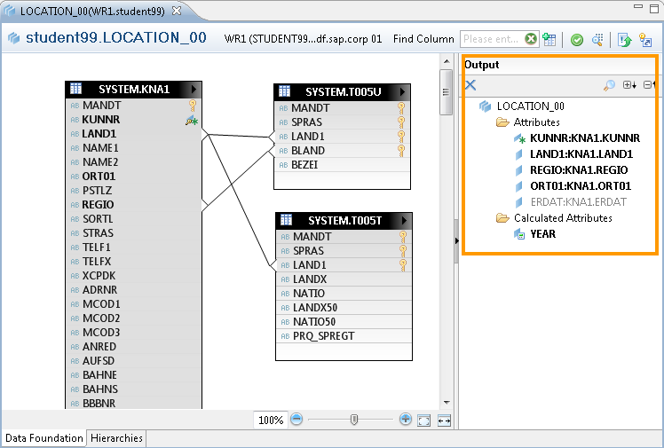
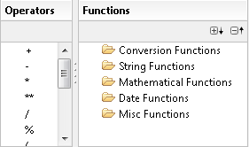
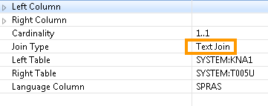
使用HANA Studio进行数据建模
HANA Studio基于Eclipse实现可视化开发

Slide 19

HANA – 开发架构场景
1. 基于HANA的商业分析
Develop business analytics scenarios on top of HANA using Business Objects tools.
Analytics
c) build analytical apps
using BOBJ tools/sdk
a) load data
HANA
b) model
2. 基于JDBC/SQL的传统模式开发
Develop applications on top of HANA using JDBC and SQL
New Apps
d) Build custom apps
using JDBC/ODBC
against HANA
JDBC/ODBC
a) load data
HANA
c) Use SQL Script or advanced libraries (e.g. Predictive Analytics)
b) model

Slide 20
HANA – 开发架构场景
3. XS引擎支持HANA原生开发
Develop lightweight apps directly on HANA
HANA
d) Build apps using
JavaScript/XS/HTML5
Apps
a) load data
c) Use SQL Script or advanced libraries (e.g. Predictive Analytics)
b) model
让计算更靠近数据

Slide 21


内存列式存储 使用同一份数据，加速事务型和分析型应用
ACID原则
指令集的编码优化
运算时数据汇聚
无需构建索引
数据压缩处理
优化的多核并行处理
运用非统一内存访问（NUMA）技术可以支持超大内存节点（12TB以上）
Notes:
Single Instruction, Multiple Data (SIMD) - the same processor operation works on multiple data blocks simultaneously
New workload class to provide more granular controls

Slide 22
多租户数据库 降低资本和运营开支 - 云就绪
垂直扩展
系统数据库
系统级别的参数配置
全量备份整个数据库
静态资源管理(CPU, memory, disk for specific database)
租户数据库
在一个HANA系统上多个严格分离的数据库租户
租户特定的生命周期维护，包括备份/恢复
清晰的应用数据分离和用户管理
每一个租户数据库有本地用户管理
每一个租户数据库拥有自己的会话和交易管理
可以迁移和复制租住数据库导其他的系统
SAP HANA Tenant A
SAP HANA Tenant B
SAP HANA Tenant C
System Tenant
SAP HANA Node
SAP HANA System : SID
水平扩展
System Tenant
System Tenant (Standby)
System Tenant (Standby)
System Tenant (Standby)
Tenant A.1
Tenant A.2
Tenant A.3
Tenant B.1
Tenant B.2
Tenant C
Standby Node
Node 1
Node 2
Node 3
SAP HANA System : SID
Notes:
Strong separation of data and users among tenant databases
Simpler administration
Manage all databases as a unit
Provision new databases
Move database/applications to different nodes
Manage resources - allocate memory and/or CPU per database
Better utilization of system resources to reduce capital expenditure
From the end use and application perspective, tenant database appears as a dedicated database
Make existing applications multitenant
Tenant databases can spread over multiple nodes

Slide 23

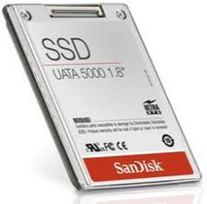
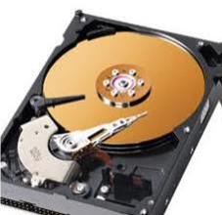








SAP HANA 动态分层技术
热数据
In DB
In memory
No restrictions, all features available
HANA column store
Priority and Data Volume
Performance and Price
温数据
HANA
In DB
On disk
No restrictions, all features available
Non-Active Data Concept / Disk store of dynamic tiering
冷数据 (NLS)
External to DB
Near-line Storage
Read access, no updates
Near-line Storage
Archive
归档
External to DB
Archive storage
No read access or updates
Traditional Archive
列存储内存数据库 OLTP+OLAP
多核大规模并行计算
高级压缩
多租户
动态分层存储
数据模型
开放的标准
高可用性和灾难恢复
This is the current state of planning and may be changed by SAP at any time.

Slide 24
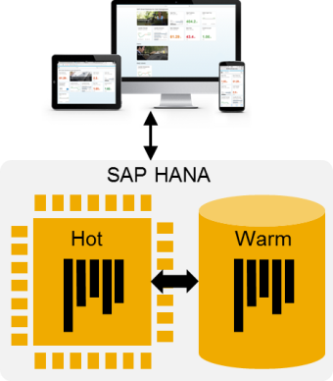
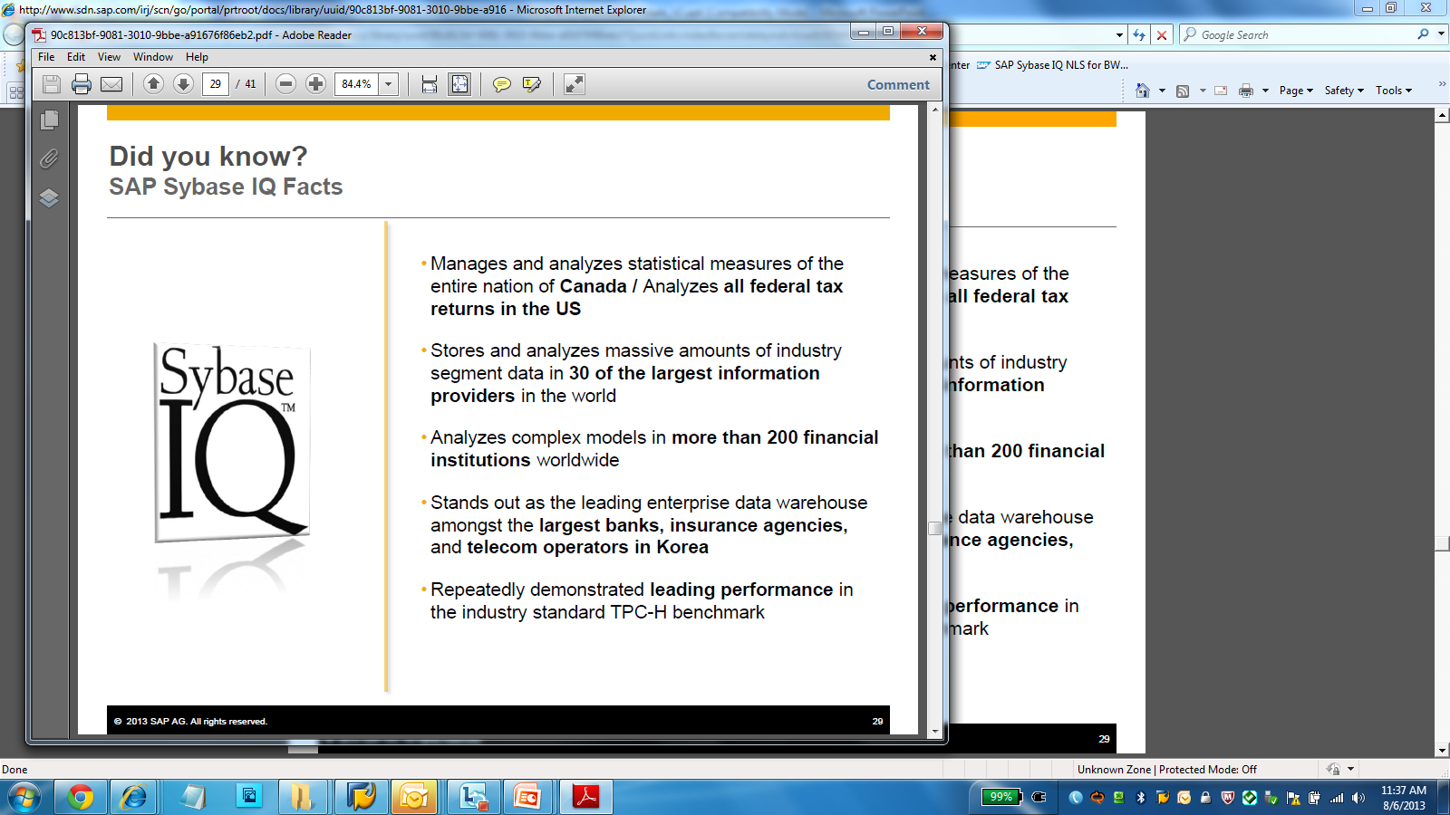
HANA动态数据分层 内存和磁盘之间的合适的价格/性能平衡
在高度集成的系统内，提供高性能的数据管理，支持可扩展架构
能力
基于表级别定义数据管理层：内存处理 (热数据) 或磁盘处理 (温数据)
利用磁盘级的列存储技术，提高数据分析访问性能
可支持高达PB级的数据规模
提供集成的安全策略与备份恢复能力
动态分层处理引擎
列式处理引擎的先驱与领导者
久经考验的数据处理引擎（大量政府、金融、电信等行业）
在TPC-H基准的领先者
优势
库内集成，高性能
单一系统，消除了数据冗余
统一访问接口，降低复杂度
邮政可根据需要定义数据管理策略
动态分层支持海量数据管理
Notes:
V1 release. Cost effective warm data storage (via disk). Support penta-scale deployments.
-Price performance advantage
-Decide how much on memory and how much on disk

Slide 25


与Hadoop的深度集成 更广泛的支持HDFS架构
支持丰富的Hadoop处理引擎，支持主要的Hadoop厂商，如Cloudera, Hortonworks, MapR等
Smart Data Access
将外部的数据源映射为本地的数据表，做到实时访问外部数据源
支持与Hadoop，Teradata, Microsoft SQLServer, Oracle, IBM DB2, IBM Netezza等数据库的集成
Virtual UDF (vUDF)
可自定义的数据联邦类型
支持访问Hadoop分布式文件系统(HDFS)，无需Mapper/Reducer解析包
支持直接调用自定义的Map Reduce任务
vUDF可集成到SQL语句
效益
能够利用Hadoop集群中HIVE & Spark无法提供的功能 (如. Hadoop Distributed File System (HDFS) 和MapReduce)
提高非结构化数据的即席查询能力
SAP HANA
vUDF Operator
Smart Data Access
RFC Hadoop
Hadoop
Map Reduce
YARN
HDFS
HIVE
Notes:
Big Data – Smart Data Access limitation HIVE and SPARK.
Access new features beyond HIVE and SPARK which can be called via SQL. Link to Map Reduce jobs.

Slide 26





SAP HANA Vora 与Spark的深度集成
SAP HANA Vora 内置于 Apache Spark 执行架构之中，是一款内存计算查询引擎，能够基于 Hadoop 提供丰富的交互式分析体验。
编译查询
Apache Spark Adapter
向下钻取功能
SAP HANA Vora
SAP HANA Vora
SAP HANA Vora
其他应用
SAP HANA-ApacheSpark Adapter
Apache Spark
Apache Spark
Apache Spark
应用服务
SAP HANA 内存平台
内存存储
YARN
数据库服务
集成服务
处理服务
HDFS
文件
文件
文件
SAP HANA 平台
SAP HANA - Apache Spark Adapter 可用于提高分布式系统连接的性能
编译查询可以提高应用和数据分析 在各节点的运行效率
基于 Hadoop 的 OLAP 体验非常常见，可用于从大数据中挖掘业务洞察，比如向下钻取 HDFS 数据
Notes:
Precision decision making means having both the core data for the decision as well as contextual data available. In this deployment, SAP HANA Vora makes this easier by giving business coherence between business application (often stored in HANA) with contextual data (often gathered into Hadoop.)
Distributed big data often contains business context—the problem is often how to find business coherence between business and big data.
HANA-Spark Adapter between HANA and Spark for improved performance between distributed systems
Compiled queries enable applications & data analysis to work more efficiently across nodes
Extend familiar OLAP experience on Hadoop to derive business coherent insights from big data with additions such as data hierarchies in SparkSQL

Slide 27
R集成 透明地使用领先的开源数据挖掘软件
在SQL Script 嵌入R
远程在 R Server上执行 R脚本
并行执行R处理进行el
利用超过5000+ R 静态或图形化库类函数
SAP HANA Platform
Query Processor
R Server
R Client
R-code
Input data in R Format
R Process
Results in R Format
Notes:
The traditional way for R developers to use a database is via an JDBC/ODBC interface, but this incurs a heavy penalty, due to data-type transformations.
A data frame is used for storing data tables. It is a list of vectors of equal length. For example, the following variable df is a data frame containing three vectors n, s, b.
> n = c(2, 3, 5) > s = c("aa", "bb", "cc") > b = c(TRUE, FALSE, TRUE) > df = data.frame(n, s, b) # df is a data frame

Slide 28

预测分析
65+ 预先包装的预测算法
支持association, clustering, classification, regression, time series 等.
AFM图形化建模工具支持开发使用PAL和R-脚本开发预测型应用程序
当使用SAP Predictive Analytics 产品时可以调用APL (Automated Predictive Libraries) 库和PAL
SAS处理支持多种HANA的原生算法
透明地使用R高级函数功能（可在HANA Procedure中调用）
对多种类型的数据进行预测分析
SAP HANA Studio / Web IDE
SAP 预测分析
Application Function Modeler (AFM)
工具和应用
SAP HANA平台
Predictive Analysis Libraries (PAL)
Automated Predictive Libraries (APL)
SAS 嵌入式 处理
R集成
Notes:
SAP HANA Application Function Modeler creates flowgraphs.
By default, the activation of a flowgraph generates a procedure in the catalog.
A flowgraph models a data flow that can contain
tables, views, and procedures from the catalog
relational operators such as projection, filter, union, and join
functions from Application Function Libraries (AFL) installed on your system
attribute view and calculation view development objects
In addition the AFM provides support for some optional components of the SAP HANA Platform such as
the Business Function Library
the Predictive Analysis Library
R Scripts
Data Provisioning operators
the generation of task plans

Slide 29




搜索、文本分析和挖掘 挖掘非结构化数据的信息
以文本或是二进制格式存储非机构化信息，以便进行搜索和文本分析
支持多种数据格式 (txt, html, xml, pdf, doc, ppt, xls, rtf, msg)
自动监测33种语言
搜索
可以使用SQL进行模糊、语义、同义词搜索
文本分析
从文本中提取相关信息 (语言标记, 谓词分析, 情绪提取等)
文本挖掘
与一组预定义的文档、关键词进行排名与归类
SAP HANA Platform
Search Engine
Text Analytics
Linguistic Processing
Entity, Fact Extraction
Text Mining
Notes:
Linguistic Markup: Tokenization, uninflected forms / stemming, part of speech
File Filtering
Unlock text from binary documents
Ability to extract and process unstructured text data from various file formats (txt, html, xml, pdf, doc, ppt, xls, rtf, msg)
Load binary, flat, and other documents directly into HANA for native text search and analysis
Native Text Analysis
Give structure to unstructured textual content
Expose linguistic markup for text mining uses
Classify entities (people, companies, things, etc.)
Identify domain facts (sentiments, topics, requests, etc.)
Supports up to 31 languages for linguistic mark-up and extraction dictionary and 11 languages for predefined core extractions
Native Text Mining
Identify related documents
Identify relevant key terms of a document
Identify related terms
Categorize new documents based on a document set
Capabilities
An optional index that is built from the results of the linguistic analysis
Provides a XS JavaScript API for Text Mining calls
Full support for English only with SPS 09
Scenarios & Examples
Highlight the key terms when viewing a patent, engineering, or R&D document
Identify similar incidents for faster problem solving
Categorize new scientific papers along a hierarchy of topics

Slide 30

SAP HANA高可用性集群 具备自动故障切换的水平扩展Scale-Out with Host Auto-Failover
可水平扩展集群
当垂直扩展达到极限时，通过集群方式扩展系统的处理能力
简便地实现服务器的热备方案
主机级自动故障转移
集群的状态由HANA的命名服务来管理。
定期检查群集成员是否仍然活跃。
如果有问题，他发起了全自动接管到备用硬件。
通过磁盘的挂载和切换故障节点的服务将被移植到备用节点上。
HANA持久化层需要通过共享的文件系统实现，可采用分布式文件系统，也可以使用磁盘阵列
存储接口API确保重新挂载必要的文件系统进入待机主机的可能性
更多细节内容: SAP Note 1900823 - Storage Connector API ⇨ Please check its attachments for white papers etc.
Server 1
Name server
Server 2
Name server
Server 3
Name server
SAN Storage
Shared Storage
Server 4
Name server
Storage Connector API
Server 5
Name server
Server 6
Name server
Standby Server
Name server
Minimalistic setup for only HA:
Server 1
Name server
SAN Storage
Storage Connector API
Standby Server
Name server
Notes:
(https://service.sap.com/sap/support/notes/1900823)

Slide 31
SAP HANA灾难恢复: 系统复制 跨数据中心集群，DB控制数据的同步
Clients
Application Servers
系统复制特点
快速地角色切换（支持灾备系统内存数据的预装载）
维护数据库级别的一致性
支持同步与异步方式
复制技术
基于提交的日志（COMMIT）由SAP HANA数据库（包括初始数据传输）控制
Step-by-Step Implementation Guide:
https://scn.sap.com/docs/DOC-47702
Data Center 1
Data Center 2
HA Solution Partner
HA Solution Partner
OS: DNS, hostnames, virt. IPs
Primary (active)
Secondary (active, data pre-loaded)
Name Server
Name Server
Name Server
Transfer by HANA database kernel
Name Server
Name Server
Name Server
Index server
Index server
Index server
Index server
Index server
Index server
OS: Mounts
Data Volumes
Data Volumes
Data Volumes
Data Volumes
Log Volume
Log Volume
Log Volume
Log Volume

Slide 32
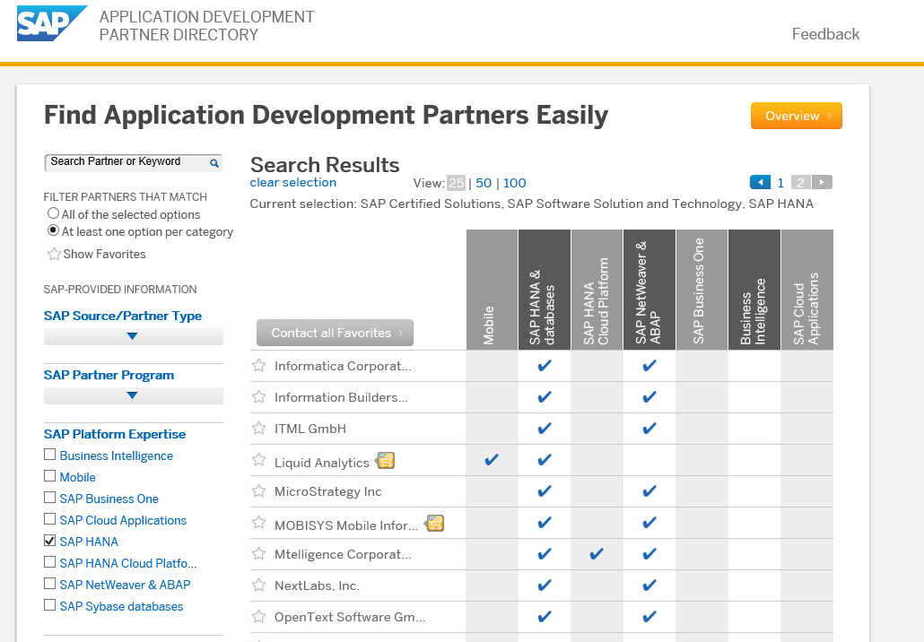





SAP HANA 认证的第三方工具与方案
BI工具
Microsoft Excel, Microstrategy, Information Builders, Cognos, Birst, ArcPlan, WebFocus, Bissantz
Customers tested (Not Certified): Tableau, Tibco Spotfire, Qlikview, OBIEE
ETL工具
Informatica, SAS, IBM Infosphere Information Server 9.1, BackOffice Associates
备份与恢复工具
Symantec (NetBackup), IBM (Tivoli Storage Manager for Enterprise), Commvault (Simpana), HP (Data Protector), EMC (Data Domain Boost, Networker), SEP (Sesam)
监控、告警与任务调度工具
Centerity (BSM, SP), Blue Medora (Ops MP for SAP HANA), DataVard (Canary Code), Syslink (Xandria), Bradmark (Surveillance DB), Axibase (AER for SAP HANA), Ozsoft (HANA Management Pack), Fujitsu (FlexFrame), Orchestrator, BMC (Patrol)
身份管理工具
Microsoft Active Directory (ADF)
基于SAP HANA认证过的第三方应用 - 75
Notes:
https://jam4.sapjam.com/wiki/show/rImnyb6jmvy7RNrDOcuuLa
HANA SW Certifications : http://global.sap.com/community/ebook/2013_09_adpd/enEN/search.html
Operations: http://global.sap.com/community/ebook/2012_Partner_Guide/partner-list.html#categories=SAP%20HANA&reg;=true&page=1
Backup/recovery: http://scn.sap.com/docs/DOC-34483
Third-Party BI Client Tools: http://scn.sap.com/docs/DOC-45681
SAP Integration Certification for SAP HANA Cloud : http://scn.sap.com/docs/DOC-41275

Slide 33
为什么选择SAP HANA平台?

Slide 34
内存计算技术为数据架构变革提供可能性 只有数据在内存中处理才能满足实时要求
Manufacturing App
Finance App
Sales App
Analytics App
Service App
Spatial App
Streaming App
Predictive App
适用于所有应用的内存计算平台
Logic
Logic
Logic
Logic
Logic
Logic
Logic
Logic
Data
无需等待数据处理
同一平台处理分析型和事务型应用
能够处理广泛 的数据类型
实时
简化
创新

Slide 35
SAP HANA平台 数据和应用管理平台
所有的设备
SAP, ISV以及客户应用
SAP HANA Platform
应用服务
数据库服务
集成服务
所有数据
开放平台
OLTP + OLAP
无需数据副本

Slide 36

SAP Unique Value: One Open Platform for Everything
IoT Platform
SAP HANA Cloud Platform
S/4HANA
SAP Analytics
System of Record
System of Innovation
System of Differentiation
HANA Platform
any DB
Hadoop
Notes:
SAP’s Unique Value is One open Platform.
The customers can start everywhere and do project in parallel based on the concept of the Pace Layered Innovation Strategy : IoT projects, Analytics, ERP consolidation.
It is all based on platform leveraging the same technology building blocks.
The big advantage for our customers is two-fold:
Leveraging the same technology across various systems drives efficiency of scale (shared IT resources, knowledge … )
Also Today’s Innovation can be become part of tomorrows Core. So one Platform for a Pace Layered Innovation Strategy enables scale without disruption

Slide 37











SAP HANA平台：加速支持企业数字化转型
SAP HANA 平台
企业预置型部署 | 云部署 | 混合部署
应用服务
处理服务
集成和质量服务
Web 服务器
JavaScript
空间
图表
预测
搜索
数据可视化
ELT 和复制
ALM
Fiori UX
图形建模器
应用生命周期管理
文本 分析
流式分析
序列 数据
业务功能
数据 质量
Hadoop 和 Spark 集成
远程数据
同步
数据库服务
列式存储，集 OLTP 和 OLAP 于一体
多核和并行处理
高级压缩
多租户
多层存储
数据建模
开放
管理和安全
高可用性和灾难恢复

Slide 38
Q&A

Slide 39

谢谢！
关注SAP中国，随时随地与我们互动
官方微博 (新浪)
@SAP中国 @SAP天天事
官方微信：SAP天天事 (二维码见右)

